Slide 1
Secondary Containment
“What is Sufficiently Impervious”
3rd ANNUAL NATIONAL INTSTITUTE for STORAGE TANK MANAGEMENT CONFERENCE
SAINT LOUIS, MISSOURI
OCTOBER 17, 2012
James B. Fels, R.G.
Senior Geologist
GREDELL Engineering Resources, Inc.
ENVIRONMENTAL ENGINEERING LAND - AIR - WATER
Offices in Jefferson City, Rolla, Springfield and St. Louis, Missouri.

Slide 2
GREDELL ENGINEERING EXPERIENCE & FOCUS
Specialized, Highly Experienced Consulting Firm
Engineering Design
Subsurface and Groundwater Investigations
Environmental Remediation, Compliance & Permitting
Regulatory Consulting
Project Management
Small to Large Projects; Private and Public Clients
Average Experience of Staff >25 Years
GREDELL Engineering Resources, Inc.

Slide 3
SECONDARY CONTAINMENT
Secondary Containment Structures for ASTs
Earthen berms (i.e., compacted clay soil) and floor.
Concrete without cracks or sealed.
Combination of concrete and earthen floor.
Geosynthetic, or other type of liner in combination with concrete and earthen materials substructure.
GREDELL Engineering Resources, Inc.

Slide 4
SOIL BERMS & SOIL FLOOR
GREDELL Engineering Resources, Inc.

Slide 5
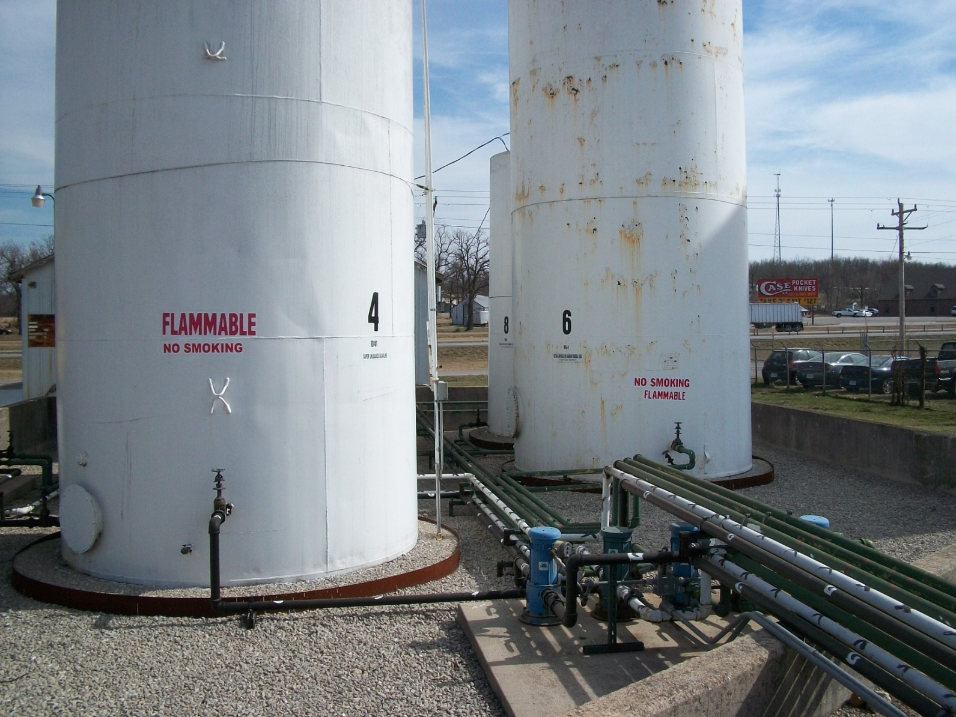
CONCRETE WALLS & SOIL FLOOR
GREDELL Engineering Resources, Inc.

Slide 6
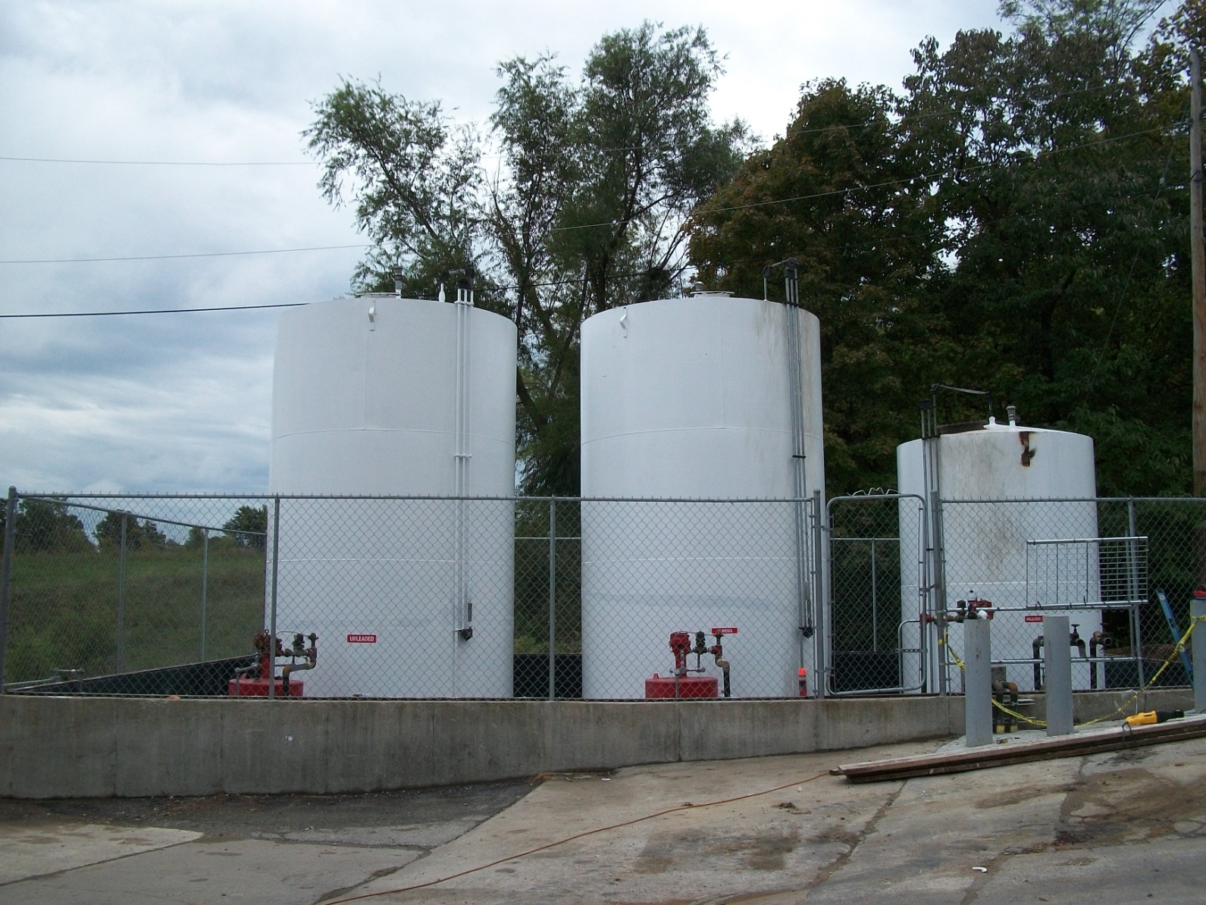
CONCRETE WALLS & GEOSYNTHETIC
GREDELL Engineering Resources, Inc.

Slide 7
Mo. Dept. of Agriculture Regulations
According to the Department of Agriculture regulations (2 CSR 90-30), "the secondary containment shall be constructed of earth, steel, concrete or solid masonry that is compatible with the specifications of the product being stored, that is liquid tight and have the ability to contain any released product until corrective action, such as the removal of released product and subsequent cleanup including soil and groundwater, can occur."
GREDELL Engineering Resources, Inc.

Slide 8
INTERPRETATION OF MDAg REGULATION
Secondary containment construction materials must be “liquid tight” and they must have the “ability to contain”.
Assumes some amount of infiltration that is acceptable.
Timeframe for removal of contained product is not mentioned.
Anywhere from 4 to 24 hours would be a fair estimate for Emergency Response, but…
insert sufficiently impervious…..
GREDELL Engineering Resources, Inc.

Slide 9
‘SUFFICIENTLY IMPERVIOUS’ DEFINITION
According to the Steel Tank Institute, sufficiently impervious means "sufficient resistance to diffusion and transport of hydrocarbon or other chemical substances to prevent contamination of the environment until cleanup occurs. Determination of 'sufficiently impervious' is a technical consideration that a Professional Engineer or other qualified professional must make. This determination is to be based on sound technical considerations, the site specific conditions as well as risk based considerations, such that ground and groundwater contamination is prevented, using current normally accepted engineering practices and principles."
GREDELL Engineering Resources, Inc.

Slide 10
INTERPRETATION OF STI REGULATION
Vague with regard to specific details needed to demonstrate "sufficient resistance”.
No mention of acceptable hydraulic conductivity values, acceptable seepage rates, acceptable time frame for cleanup to occur, etc.
Vague with regard to risk associated with site conditions and evaluations.
GREDELL Engineering Resources, Inc.

Slide 11
GREDELL Engineering’s Solution
Developed a process to inspect, document and assess the containment area according to the items listed in the Steel Tank Institute definition (site specific conditions, soil type, geologic surroundings, hydrologic parameters of soil and bedrock, surrounding land use).
Rely on technical consideration of the risk based evaluations and the potential for soil and groundwater contamination as described in the MDNR Risk Based Corrective Action Guidance Document for Tank Sites.
GREDELL Engineering Resources, Inc.

Slide 12
GREDELL ENGINEERINGS PROCESS
Utilize Missouri Environmental Geology Atlas (MEGA) for site geologic conditions and known water wells.
Depth to bedrock, karst, springs, faults, etc.
¼-mile radius private wells.
1-mile radius public wells.
GREDELL Engineering Resources, Inc.

Slide 13
GREDELL ENGINEERINGS PROCESS
Utilize Web Soil Survey (WSS) for soil data and information produced by the National Cooperative Soil Survey operated by the USDA Natural Resources Conservation Service (NRCS).
Soil Map Unit Descriptions (i.e., texture, structure, etc.).
Suitabilities and Limitations (i.e., pond reservoir, percent clay, etc.).
GREDELL Engineering Resources, Inc.

Slide 14
ON-SITE INSPECTION
Vertical and horizontal conduits.
Cracks in concrete.
Drain valves.
Product lines and utilities plumbed through berms, walls or beneath the secondary containment structure.
Soil texture (e.g., sand).
Constructed on bedrock (e.g., fractures).
Water wells, cisterns, and utilities on site.
GREDELL Engineering Resources, Inc.

Slide 15
ON-SITE INSPECTION CONT.
Soil borings advanced in earthen structures
Less than 40-inches below floor.
Describe soil texture, water content, horizon, etc.
Note petroleum odor and moisture in subsurface borings. Of importance is if odor and moisture content decreases with depth.
Documentation
Site sketch including secondary containment structure, ASTs, and utilities.
Photographs.
GREDELL Engineering Resources, Inc.

Slide 16
REPORTING
Site Features (i.e., number of ASTs, product stored, type of facility, personnel on site during normal business hours)
Physical Properties (i.e., soils, geology, water wells, land use, utilities).
Site Visit Documentation (i.e., number of borings, soil descriptions, evidence of standing water, type of vegetation, if any, in the containment area, photographs).
GREDELL Engineering Resources, Inc.

Slide 17
REPORTING CONT.
Summary
Findings and recommendations.
Scope and Limitations
Does not evaluate or address any other issues pertinent to secondary containment such as sufficient holding capacity of the structure, tank or pipe integrity, historic release, or any other technical or regulatory considerations that might be applicable.
GREDELL Engineering Resources, Inc.

Slide 18
REPORTING CONT.
Conclusions
Meets interpretation of the Sufficiently Impervious definition.
Does Not Meet interpretation of the Sufficiently Impervious definition.
Recommend additional testing or procedures in order to further characterize the site or to meet the interpretation of the Sufficiently Impervious definition.
GREDELL Engineering Resources, Inc.

Slide 19
RECOMMENDATIONS
Further assessment (permeability laboratory testing, water seepage assessment)
Permeability Laboratory Testing
Undisturbed soil sample (shelby tube)
Triangular permeability test to demonstrate in-situ permeability of soil within secondary containment
Water Seepage Loss Assessment
Add known volume of water to secondary containment structure.
Measure loss and calculate rate of infiltration.
24-hour assessment.
Minor repairs (e.g., seal cracks, repair drain valve).
Major repairs (e.g., reroute product lines, geosynthetic liner, spray-on liner or clay liner installation).
GREDELL Engineering Resources, Inc.

Slide 20
WATER SEEPAGE LOSS ASSESSMENT
GREDELL Engineering Resources, Inc.

Slide 21
WATER SEEPAGE LOSS ASSESSMENT
VIDEO
GREDELL Engineering Resources, Inc.

Slide 22
QUESTIONS? COMMENTS?
GREDELL Engineering Resources, Inc.
ENVIRONMENTAL ENGINEERING LAND - AIR - WATER
Offices in Jefferson City, Rolla, Springfield and St. Louis, Missouri.
901 N. PINE STREET
ROLLA, MO
573-426-6433
www.ger-inc.biz

